Slide 1
Human Adipose Derived Stem Cells’ Response To Changes In Gravitational Force
And Its Effects On Musculoskeletal Tissue Growth And Development
Carmelo Moraila
Dr. John Szivek
Orthopaedic Research Lab
April 11, 2014

Slide 2
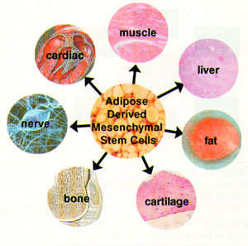
Objective
Gravitational conditions
Growth factors
  BMP-2
Substrate environments
  Human bone plugs
  Scaffolds
‪www.vet-stem.com

Slide 3
Methods
Cell expansion
Perfusion and cell placement
Hypergravity
Methyl Methacrylate(MMA) embedding

Slide 4
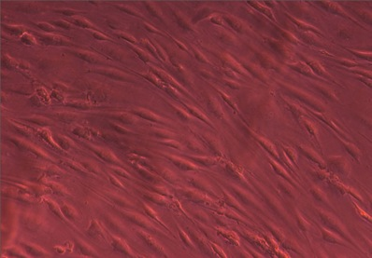
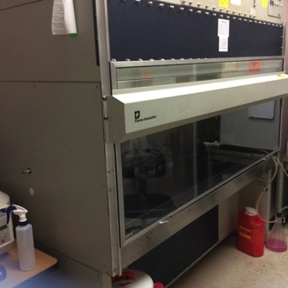
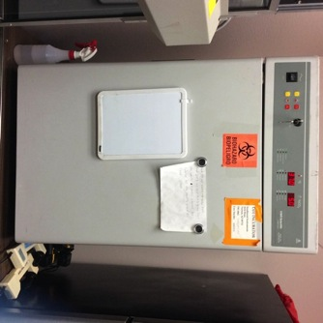
Cell Expansion
Cell origins
Thawed
Expansion
Control sample
cells
Sterile hood
Incubator

Slide 5
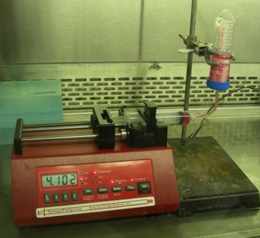
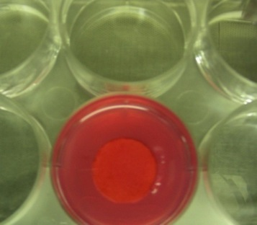
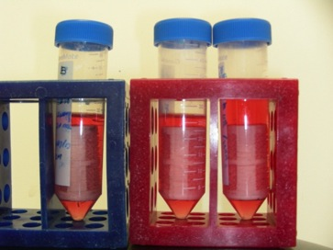
Perfusion and Cell Placement
Scaffold perfusion
Syringe pump
Six well plate
#2 SCEM/Centrifuge
Bone plug
Scaffold in media

Slide 6
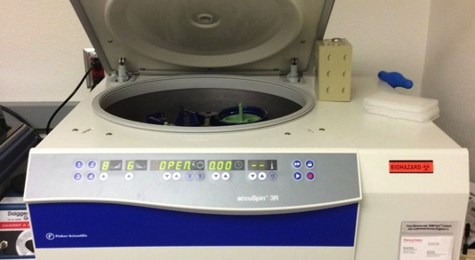
Hypergravity
Gravitational force
16 g
Duration
9 minutes per day
23 continuous days
Centrifuge

Slide 7
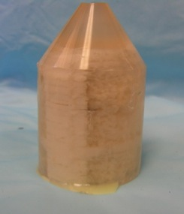
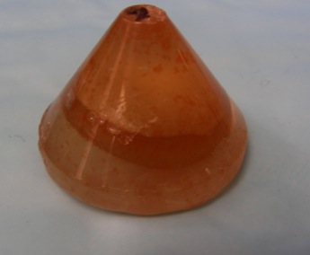
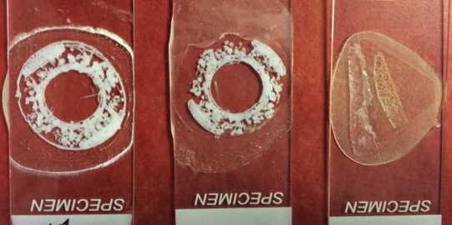
Methyl Methacrylate(MMA)
Embedding
Fixing
Dehydration
MMA protocol
Cut and polish
Embedded scaffold
Embedded bone plug
Scaffold and bone slides

Slide 8
Analysis Techniques
Alamar Blue Assay
Scanning Electron Microscopy (SEM)
Histology
  MIBs(Mineralized Bone Stain), also known as Villanueva Osteochrome Bone Stain
  Safranin O
  Alizarin red

Slide 9
Results and Interpretation
Alamar Blue Assay
Control
  Control demonstrated
  80.78% viability
SCEM with centrifugation
  SCEM demonstrated
  63.72% viability
  Inhibited growth 16.2%
SCEM +BMP-2 with centrifugation
  SCEM + BMP-2 demonstrated 68.76% viability
  Inhibited growth 7.4%

Slide 10
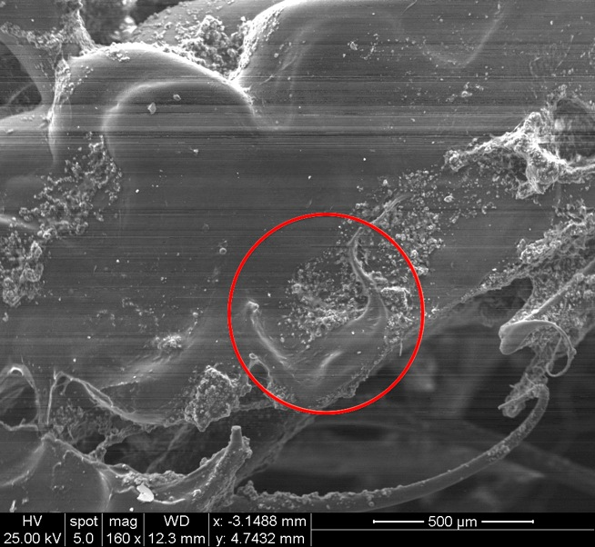
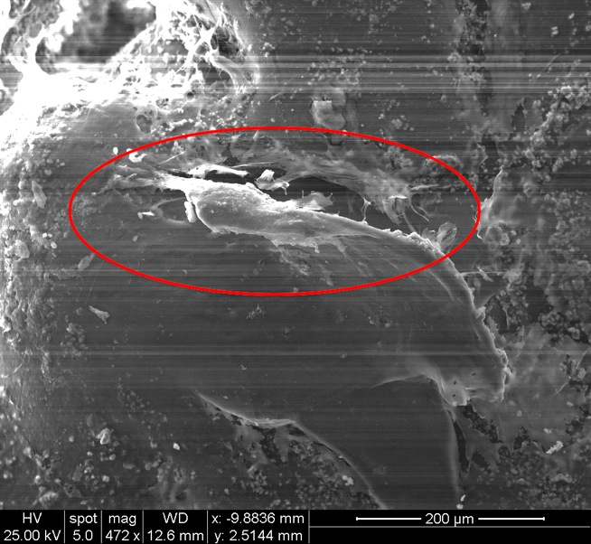
Results and Interpretation
Scanning Electron Microscopy
Scaffold surface
Cell attachment
Cell attachment
Scaffold surface

Slide 11
Results and Interpretation
Histology
 | #1 Control Bone Plug | #2 Bone Plug SCEM | #3 Bone Plug SCEM + BMP-2 | #4 Control Scaffold | #5 Scaffold SCEM | #6 Scaffold SCEM + BMP-2
Slide 1 | MIBs | MIBs | MIBs | Safranin O | Safranin O | MIBs
Slide 2 | Safranin O | MIBs | Safranin O | MIBs | Alizarin Red | Alizarin Red
Slide 3 | MIBs | Safranin O | MIBs | MIBs | MIBs | Alizarin Red

Slide 12
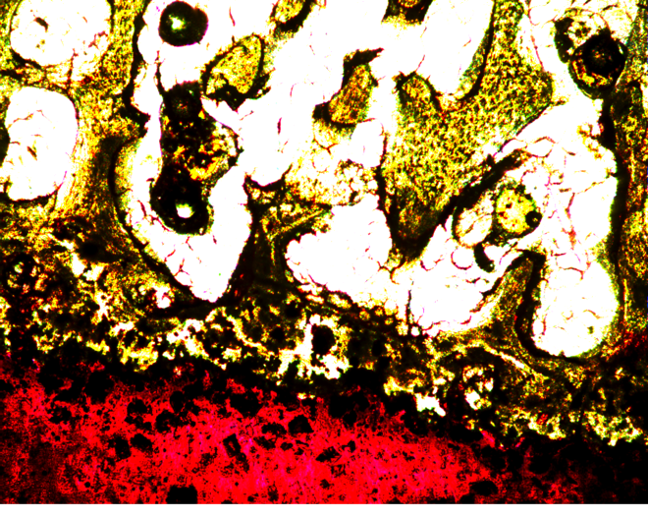
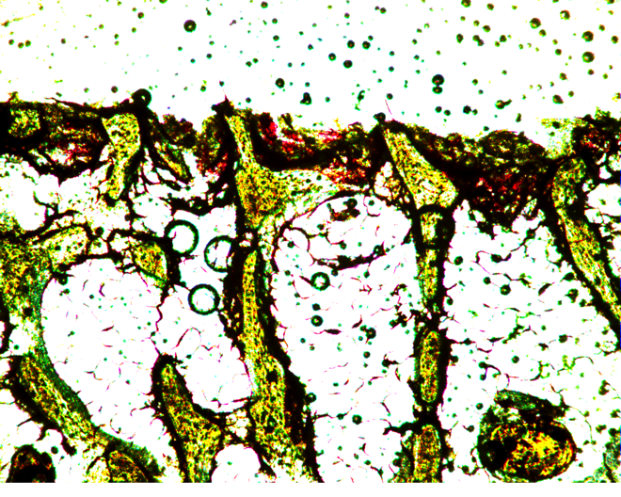
Results and Interpretation
Histology (MIBs)
Bone
Engineered cartilage
Native cartilage
Bone

Slide 13
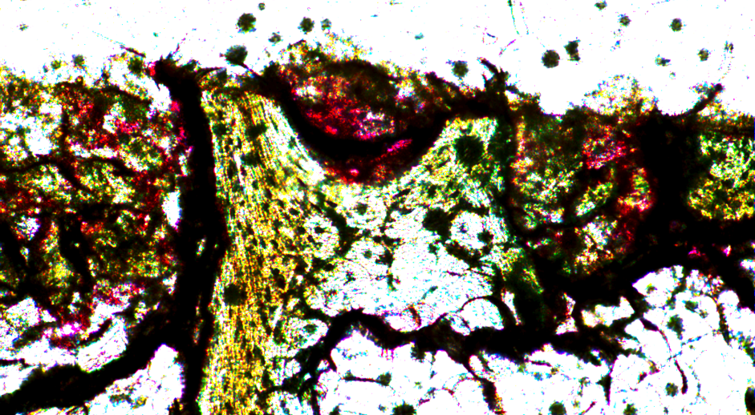
Results and Interpretation
Histology(MIBs)
Engineered cartilage
Bone

Slide 14
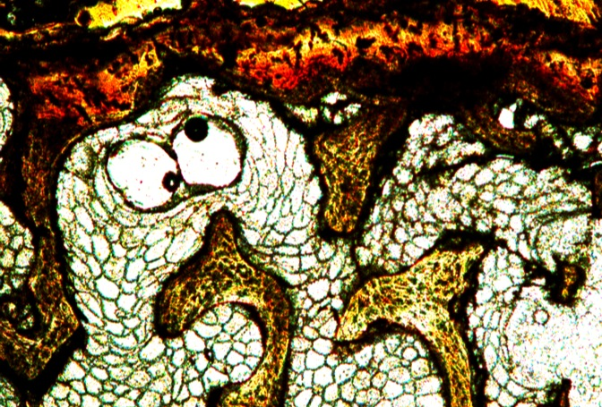
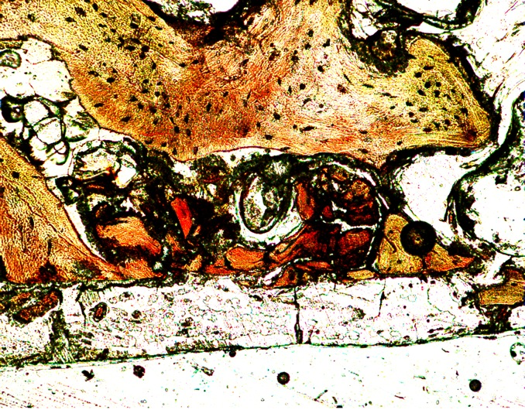
Results and Interpretation
Histology (Safranin O)
Bone
Native cartilage
Bone
Engineered cartilage

Slide 15
Conclusion
Cell viability
Cellular adhesion molecules
Cell differentiation

Slide 16
Acknowledgements
UA/NASA Space Grant
Orthopaedic Research Lab
  Dr. John Szivek
  David Gonzales
WAESO (Western Alliance to Expand Student Opportunities)

Slide 17
Thank you

